Slide 1

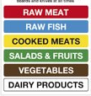
Y7 Food Technology
K
N
O
W
L
E
D
G
E
O
R
G
A
N
I
S
E
R
Lesson 1. Equipment and cooking safety
Knife Safety
Carry sharp knives by your side, blade downwards pointing towards the floor
Use the appropriate size knife for the food to be cut
Use the bridge and claw method when cutting
Never place knives in washing up water where they can’t be seen
Wash carefully with the sharp edge of the blade facing away from you
Different colour chopping boards to avoid cross contamination
Lesson 2. Cross contamination. The 4Cs
Key terms | Definition
Pathogenic bacteria | Bacteria that causes food poisoning
The 4 C’S The 4 C’s cover the main ways to prevent food poisoning.
Cleaning | Cleaning the kitchen is important to keep food safe and to prevent bacteria from spreading
Cooking | Bacteria is destroyed at temperatures above 63°c
Chilling | The reproduction of bacteria is slowed down at lower temperatures
Cross Contamination | Cross contamination occurs when bacteria is transferred from food or surface to another.
Perishable foods | Foods that become unsafe to eat or spoil quickly if not kept refrigerated
High risk foods | Foods that are more likely to harbour dangerous bacteria if not kept within a certain temperature
Use by | Do not food after this date
Best before | You can eat food after this date but it might not be at its best quality
Key temperatures
-18C -> Freezer temperature
3-5C -> Fridge temperature
5-63C -> Danger Zone
63C-> Hot holding temperature (max 90 min)
75C-> Core cooking temperature (for 2 min)

Slide 2
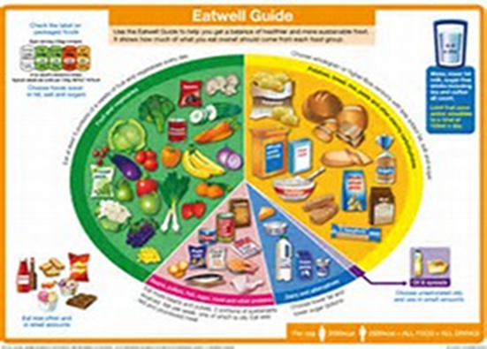
Y7 Food Technology
Lesson 3. The Eatwell Guide
The Eatwell guide shows the types and proportions of foods we need to eat on a daily basis to have a healthy diet.
K
N
O
W
L
E
D
G
E
O
R
G
A
N
I
S
E
R
Food groups
Carbohydrates: Foods: Bread, pasta, rice, potato. Choose wholegrain over white. Nutrient: carbohydrate. Function: energy
Fruits and vegetables. Foods: banana, orange, broccoli. Consume 5 a day. Nutrients: vitamins and minerals. Function: strong immune system.
Proteins: Foods: chicken, meat, fish, eggs, lentils, nuts. Aim to consume 2 portions of fish a week. Nutrient: proteins. Function: growth and repair of muscles and cells.
Dairy and alternatives: Foods: milk, cheese, yogurt, soya milk. Chose low fat low sugar options. Nutrients: vitamins and minerals (calcium). Function: strong immune system and strong bones.
Fats and oils: Foods: butter, oil. Chose oil over butter. Nutrient: fats. Function: energy, insulation of organs, regulation of body temperature.
Fibre and water are not considered nutrients but they are beneficial for our health too.
Lesson 4. Food Labels
The following information must appear by law on food labels:​
1. Name
2. Ingredients (including allergens in bold and additives)
3. Weight
4. Storage / preparation instructions
5. Manufacturer / distributor details
6. Use by / best before
7. Nutritional information
8. Country of origin
The traffic light label is not mandatory but is advisable to spot at
a glance better food options. “When choosing similar products,
choose more greens and less reds”

